Slide 1
أكـــــاديميــــة طــــويـــق
Scalable Data Science

Slide 2
Cloud Collaboration Tools
By: Dr. Afshan Hashmi

Slide 3
Course Objectives:
Understand what cloud collaboration tools are and why they are important.
Identify popular cloud collaboration platforms and their core features.
Compare different tools based on functionality, accessibility, and security.
Demonstrate the use of common cloud collaboration tools through practical examples.

Slide 4
Introduction to Cloud Collaboration
What is Cloud Collaboration?
Cloud Collaboration refers to the practice of using cloud computing technologies that allow multiple people to:
Work together on documents, files, or projects
Access and edit content in real-time
From anywhere with an internet connection
Instead of storing files on a local device, cloud collaboration platforms store them on remote servers (the cloud), making it easy for teams to collaborate even if they are not in the same location.
Key Features of Cloud Collaboration:
Real-time Editing: Multiple users can edit the same document at the same time.
Automatic Saving & Versioning: Changes are saved automatically, and previous versions are often stored.
Remote Access: Files can be accessed anytime, anywhere.
File Sharing: Easy to share with teams or external stakeholders.
Integrated Communication: Chat, comments, and video calls often integrated into the tools.

Slide 5
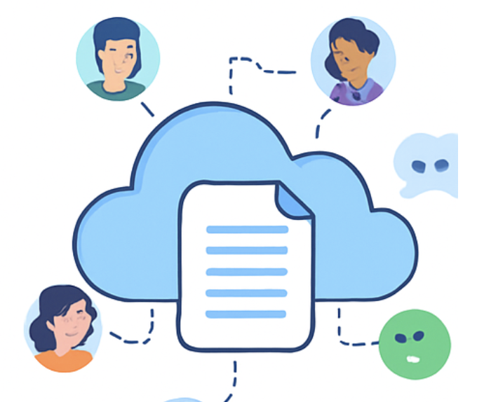
Why Use Cloud Collaboration Tools?
1. Supports Remote and Hybrid Work Models
With more people working from home or from different locations, cloud tools ensure everyone stays connected and productive.
2. Facilitates Teamwork Across Geographic Boundaries
Teams in different cities or countries can collaborate as if they were in the same room.
3. Enhances Productivity and Communication
Instant updates and seamless communication reduce misunderstandings and improve workflow.
Saves time no need to send files back and forth by email.
Examples of Cloud Collaboration Tools:
Google Workspace (Docs, Sheets, Drive)
Microsoft 365 (Word Online, OneDrive, Teams)
Slack with file sharing
Trello / Asana for task management
Zoom / Microsoft Teams for meetings and screen sharing

Slide 6

Key Features of Cloud Collaboration Tools
Real-time Editing
Multiple users can edit the same document or file at the same time.
Changes appear instantly for everyone.
Example: Google Docs lets your team write, edit, and see updates live.
Version Control
Keeps a history of all changes made to a document.
You can track who edited what and when.
Option to revert to previous versions if needed.
File Sharing
Share files securely with team members or external collaborators.
Set permissions: view-only, comment, or edit.
No need to email attachments just share a link.

Slide 7
Key Features of Cloud Collaboration Tools
Commenting & Feedback
Leave inline comments directly on documents.
Tag teammates using @mention to notify them.
Makes feedback clear, organized, and action-oriented.
Integration
Works smoothly with other tools like:
Calendars (e.g., Google Calendar)
Project management (e.g., Trello, Asana)
Communication apps (e.g., Slack, Microsoft Teams)
Keeps everything connected in one place.
Security
Strong protection through:
User permissions (who can see or edit)
Access control (limit by team, device, or IP)
Data encryption (to keep content private and secure)

Slide 8
Common Cloud Collaboration Tools
Cloud collaboration tools help teams work together in real time, share files, manage tasks, and communicate effectively especially in remote or hybrid work environments.
Here are some of the most widely used tools categorized by function:
1. Document Creation & File Sharing
Google Workspace
Includes: Google Docs, Sheets, Slides, and Drive.
Real-time editing, comments, version history.
Ideal for document collaboration and storage.
Microsoft 365
Includes: Word Online, Excel Online, PowerPoint, OneDrive.
Integrates with Microsoft Teams for smooth collaboration.
Strong enterprise-level support.
Dropbox
File storage and sharing platform.
Integrates with third-party apps for collaboration.
Good version control and file recovery.

Slide 9
Common Cloud Collaboration Tools
Communication & Messaging
Slack
Team messaging app with channels and direct messages.
File sharing and integration with tools like Google Drive and Trello.
Real-time collaboration and notification system.
Microsoft Teams
Combines chat, video calls, file sharing, and collaboration in one place.
Deeply integrated with Microsoft 365.
Useful for team meetings and document co-authoring.
Zoom
Video conferencing and screen sharing.
Useful for online meetings, webinars, and virtual classes.
Can be integrated with other collaboration tools.

Slide 10
Common Cloud Collaboration Tools
Project & Task Management
Trello
Visual task management using boards, lists, and cards.
Great for small teams and simple project tracking.
Easy drag-and-drop interface.
Asana
Task and project management tool.
Lets you assign tasks, set due dates, and track progress.
Integrates with email, Slack, Google Drive, etc.
ClickUp / Monday.com
All-in-one workspaces for tasks, docs, goals, and timelines.
Highly customizable workflows for teams.

Slide 11


Common Cloud Collaboration Tools
Integrated Platforms
Notion
Combines note-taking, docs, databases, and task tracking.
Customizable and great for team knowledge bases.
Real-time collaboration with rich media support.
Airtable
Like a super-powered spreadsheet.
Combines database features with a user-friendly interface.
Good for project planning and content calendars.

Slide 12
Common Cloud Collaboration Tools
Tool | Use Case | Key Features
Google Workspace (Docs, Sheets, Drive) | Document creation, editing, storage | Real-time editing, sharing, commenting, auto-save
Microsoft 365 (Word, Excel, Teams) | Business suite, communication, docs | Desktop + web versions, Teams chat, OneDrive
Slack | Messaging and team communication | Channels, file sharing, app integrations
Trello | Task and project management | Boards, cards, checklists, calendar view
Asana | Task tracking and workflows | Projects, timelines, dependencies
Zoom / Google Meet | Video conferencing | Meetings, webinars, screen sharing
Notion | Notes, knowledge base, task tracking | All-in-one workspace, templates
Dropbox | File storage and sharing | Syncing, version history, team folders

Slide 13
Key Technologies Behind Cloud Collaboration
These are the core technologies that make cloud collaboration fast, secure, and seamless.
A. Real-Time Sync
Cloud collaboration tools rely on real-time synchronization to ensure all users see the same version of a document instantly.
Operational Transformation (OT)
A method used to resolve conflicts when multiple users are editing a document at the same time.
It ensures that all changes are merged smoothly, so nothing is overwritten.
Example: Google Docs uses OT to let multiple users type on the same document without issues.
WebSockets
A communication protocol that keeps a constant connection between the user’s device and the server.
Allows instant updates to be sent in both directions no need to refresh the page.
Used in live chats, collaborative editing, dashboards, etc.

Slide 14
Key Technologies Behind Cloud Collaboration
B. Security & Compliance
Since cloud collaboration involves storing and transferring sensitive data, security is critical.
Encryption
AES-256 (Advanced Encryption Standard) is used to protect data at rest (stored data).
TLS (Transport Layer Security) protects data in transit (data being transferred between devices and servers).
Access Controls
Tools implement Role-Based Access Control (RBAC):
Admin – full control
Editor – can modify content
Viewer – read-only access
Ensures only the right people can see or edit data.
Compliance Standards
Tools often follow global standards to protect user privacy and data:
GDPR – for data protection in the EU
HIPAA – for health-related data security in the U.S.
SOC 2 – for service organization controls (audits, privacy, etc.)

Slide 15
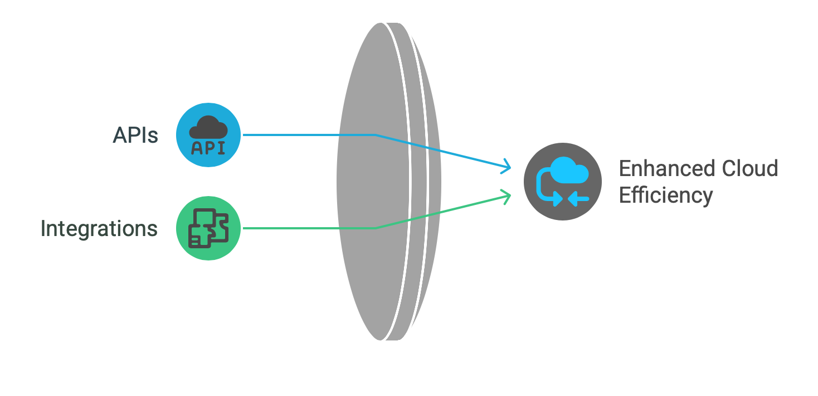
Key Technologies Behind Cloud Collaboration
C. APIs & Integrations
APIs and integrations help cloud tools communicate with each other, improving efficiency and automation.
REST APIs (Representational State Transfer)
Allow external apps or systems to connect and exchange data.
Example: Connect Slack with Google Calendar to get meeting reminders in Slack.
Webhooks
Used to send real-time alerts between systems when certain events happen.
Example: A new issue is created in GitHub → a message is sent to your Slack channel automatically.

Slide 16
Challenges and Considerations in Cloud Collaboration
While cloud collaboration tools offer many benefits, there are some challenges that teams and organizations must address:
1. Security Risks
What it is: Data stored in the cloud can be vulnerable to unauthorized access, breaches, or leaks.
Why it matters: Sensitive company or customer information may be exposed if proper security measures (like encryption and access control) aren't in place.
Example: Sharing a file with the wrong permissions can lead to accidental exposure.
2. Internet Dependency
What it is: Cloud tools rely heavily on internet connectivity.
Why it matters: If the internet is slow or unavailable, users may lose access to critical documents or live collaboration features.
Example: During a meeting, poor internet can disrupt file sharing or real-time updates.

Slide 17
Challenges and Considerations in Cloud Collaboration
3. Compatibility Issues
What it is: Different tools or file formats might not work well together.
Why it matters: Users may face difficulties when collaborating across platforms or with older file versions.
Example: A document made in Microsoft Word might lose formatting when opened in Google Docs.
4. User Training
What it is: Employees may need to learn how to use new tools or adapt to cloud-based workflows.
Why it matters: Without proper training, productivity may drop, and users may resist adopting new systems.
Example: A team used to emailing files may take time to adjust to using shared online documents.

Slide 18
Best Practices for Effective Collaboration
Effective collaboration using cloud tools requires not just the right platform, but also smart practices to ensure productivity, security, and alignment. Below are key best practices every team should follow:
1. Standardize Tools
Why it matters: Using too many tools creates confusion, duplicate work, and inefficiencies.
Best practice:
Choose one tool per function (e.g., only Asana or Trello for project management).
Establish an official toolset for communication, file storage, task tracking, etc.
Example: Use Google Workspace + Trello + Slack for your team, and ensure everyone sticks to them.

Slide 19
Best Practices for Effective Collaboration
2. Set Permissions
Why it matters: Accidental edits or unauthorized access to sensitive data can be costly.
Best practice:
Set view-only, comment, or edit permissions based on role and responsibility.
Use folder-level controls in tools like Google Drive or OneDrive.
Example: Project plans can be editable by managers, while interns get view-only access.
3. Train Teams
Why it matters: Many powerful features go unused due to lack of knowledge.
Best practice:
Provide hands-on training or short video tutorials.
Highlight features like:
@mentions for collaboration,
Version history to recover previous work,
Shortcuts for productivity.
Example: Conduct a 15-minute weekly “Tool Tips” session.

Slide 20
Best Practices for Effective Collaboration
4. Automate Workflows
Why it matters: Manual tasks waste time and increase the risk of errors.
Best practice:
Use tools like Zapier, Make (Integromat), or Power Automate to connect platforms.
Automate repetitive tasks, e.g.:
New form submission → Create a Trello card.
Slack message → Add to Google Calendar.
Example: Automatically send a daily standup reminder via Slack at 9:00 a.m.
5. Monitor Usage
Why it matters: Helps in auditing, troubleshooting, and enforcing accountability.
Best practice:
Use built-in audit logs, usage dashboards, and activity history.
Track who accessed/edited files, and monitor logins and sharing patterns.
Example: In Google Workspace Admin Console, check Drive activity reports to ensure compliance.

Slide 21
Comparison table
Feature | Google Workspace | Microsoft 365 | Slack | Trello
Real-time Editing | ✅ | ✅ | ❌ | ❌
Chat Integration | ✅ | ✅ | ✅ | ✅
File Storage | ✅ | ✅ | Limited | ❌
Task Management | ❌ | ❌ | ❌ | ✅
Cross-device Access | ✅ | ✅ | ✅ | ✅

Slide 22
Case Studies in Cloud Collaboration
Real-world examples help demonstrate how cloud collaboration tools solve specific challenges. Here are two case studies:
A. Remote Software Team
Tools Used: GitHub + Slack + Zoom Challenge:
Team members are working remotely across different time zones, making communication and coordination difficult.
Solution:
Tool | Purpose
GitHub | Used for collaborative coding, version control, and pull requests. Developers work on code branches and merge changes efficiently.
Slack | Used for daily standups, quick team updates, asynchronous discussions, and integrations (e.g., GitHub notifications).
Zoom | Used for sprint retrospectives, virtual face-to-face meetings to discuss progress, challenges, and improvements.
Outcome: Smooth code development, clear communication, and stronger team alignment across time zones.

Slide 23
Case Studies in Cloud Collaboration
B. Academic Research Group
Tools Used: Notion + Zotero Challenge: Researchers need to manage shared papers, deadlines, and citations for collaborative writing and publishing.
Solution:
Tool | Purpose
Notion | Used for task tracking, research planning, shared notes, and to-do lists for paper submissions.
Zotero Cloud | Used for reference management, organizing research papers, and sharing citations among the team.
Outcome: Organized workflow, centralized research materials,
and efficient citation management for academic writing.
.

Slide 24


Summary
Cloud collaboration tools revolutionize how teams work and communicate.
They offer convenience, flexibility, and scalability.
Choosing the right tool depends on project needs, team size, and integration requirements.

Slide 25
Reading and Resources
Google Workspace: https://workspace.google.com/
Microsoft 365: https://www.microsoft.com/microsoft-365
Trello: https://trello.com/
Slack: https://slack.com/
Notion: https://www.notion.so/

Slide 26
شــــــكــــرًا لكــــــم
THANK YOU

